Slide 1

Business Analytics
Chapter - 1
Business Analytics
Sampling & Hypothesis Testing

Slide 2
Population and Sample
Population:
An aggregate of objects or individuals under study is called
population.
Population may be a group of people suffering from a particular disease, collection of books, group of students.
Sample:
Any part of population under study is called a sample.
While purchasing food grains, we inspect only a handful of grains and draw conclusions about the quality of the whole lot. In this case handful of grains is a sample and the whole lot is a population.

Slide 3
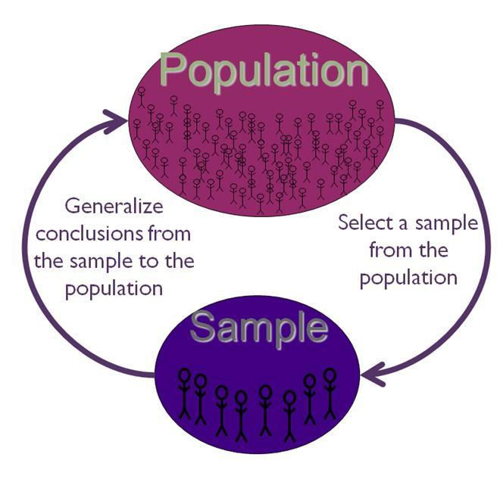
Sampling
“A sample is some portion of a population. Because many populations of interest are too large to work with directly, techniques of statistical sampling have been devised to obtain samples taken from larger populations.”
Sampling is the process by which this part is chosen.

Slide 4
Theory of Sampling
The theory of sampling is as follows:
Researchers want to gather information about a whole group of people (the population).
Researchers can only observe a part of the population (the sample).
The findings from the sample are generalized, or extended, back to the population.

Slide 5
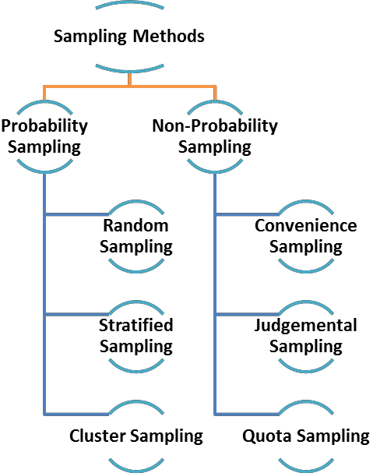
Sampling Methods

Slide 6
Advantages of Sampling
Makes the research of any type and size manageable.
Significantly saves the costs of the research.
Results in more accurate research findings.
Provides an opportunity to process the information in a more efficient
way.
Accelerates the speed of primary data collection.

Slide 7

Probability Overview
Probability - How likely something is to happen.
As you can see, with this formula, we will write the probability of an event as a fraction. The numerator (in red) is the number of chances and the denominator (in blue) is the set of all possible outcomes. This is also known as the sample space.

Slide 8
Probability Approach
Uncertainty is all around us and we often come across real-life situations when we have to decide on making a choice from the available options.
Questions like “Will it rain? Do I need to carry an umbrella today?” or “Will there be a rise in taxes? Which party will win the election this time?” All these situations demand a decision from us and this is the time when probability theory comes to our rescue.
From weather forecasts, opinion polls to making business decisions, the concepts of probability come in handy at various aspects of our daily lives.
•What are the chances?

Slide 9
Example 1
Given a standard die , determine the probability for the following events when rolling the die one time.
i)P(5) ii) P(even number) iii) P(7) (Note: P(5) means probability of rolling a 5) Sample space: {1, 2, 3, 4, 5, 6}
Number of sample points: 6
i) P(5) = # of ways outcome occurs / Total possible outcomes
= 1 / 6

Slide 10
Example 1
ii) P(even number) = 3 / 6
(Since there are 3 even numbers in the sample space)
iii)
P(7) = 0
(This is an impossible event because the die does not contain number 7. Whenever the probability is impossible, the answer is zero)

Slide 11
Example 2
There are 4 blue marbles, 5 red marbles, 1 green marble and 2 black marbles in a bag. Suppose you select 1 marble at random. Find each of the following probability.
P( black )
P( blue )
P( blue or black)
P( not green)
P( not purple)
Number of sample points: 12 ( There are 12 marbles in total ) i) P( black ) = 2 / 12 = 1 / 6
( There are 2 black marbles in the bag )

Slide 12
Example 2
ii) P(blue) = 4 / 12 = 1 / 3
( There are 4 blue marbles in the bag )
iii)
P( blue or black ) = 6 / 12 = 1 / 2
( There are 4 blue + 2 black marbles in the bag )
P( not green ) = 11 / 12
( There’s 1 green, so 12- 1 = 11 that are not green marbles )
P( not purple ) = 1
( no marble is purple )

Slide 13
Interpreting Probability Result
Mathematically, the probability that an event will occur is expressed as a number between 0 and 1.
The probability of event A is represented by P(A).
If P(A) equals zero, event A will almost definitely not occur.
If P(A) is close to zero, there is only a small chance that event A will
occur.
If P(A) equals 0.5, there is a 50-50 chance that event A will occur.
If P(A) is close to one, there is a strong chance that event A will occur.
If P(A) equals one, event A will almost definitely occur.

Slide 14
Interpreting Probability Result
In a statistical experiment, the sum of probabilities for all possible outcomes is equal to one. This means, for example, that if an experiment can have three possible outcomes (A, B, and C), then P(A) + P(B) + P(C) = 1.
Probability that the experiment results in a successful outcome (S) is:
P(S) = ( Number of successful outcomes ) / ( Total number of equally
likely outcomes ) = r / n

Slide 15
Consider the following experiment.
An urn has 10 marbles. Two marbles are red, three are green, and five are blue. If an experimenter randomly selects 1 marble from the urn, what is the probability that it will be green?
In this experiment, there are 10 equally likely outcomes, three of which are green marbles. Therefore, the probability of choosing a green marble is 3/10 or 0.30.

Slide 16

Business Analytics
Business Analytics
Probability Sampling Methods

Slide 17
Probability Sampling
Probability sampling is a sampling technique wherein the samples are gathered in a process that gives all the individuals in the population equal chances of being selected.
A researcher must identify specific sampling elements (e.g. persons) to
include in the sample.
For example, if conducting a telephone survey, the researcher needs to try to reach the specific sampled person, by calling back several times, to get an accurate sample

Slide 18
Random Sample
The term random has a very precise meaning. Each individual in the population of interest has an equal likelihood of selection. This is a very strict meaning -- you can't just collect responses on the street and have a random sample.
The assumption of an equal chance of selection means that sources such as a telephone book or voter registration lists are not adequate for providing a random sample of a community. In both these cases there will be a number of residents whose names are not listed. Telephone surveys get around this problem by random-digit dialing -- but that assumes that everyone in the population has a telephone.
The key to random selection is that there is no bias involved in the selection of the sample. Any variation between the sample characteristics and the population characteristics is only a matter of chance.

Slide 19
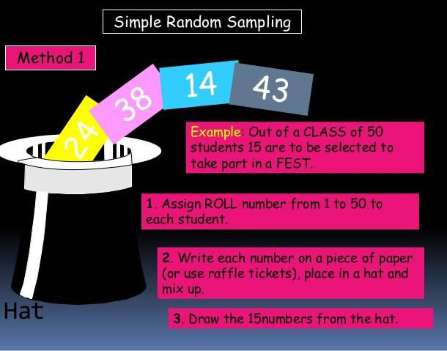
Simple Random Sampling

Slide 20
Stratified Sample
A stratified sample is a mini-reproduction of the population.
If the population is not homogeneous, SRS is not very effective.
Therefore, the entire population is divided into several homogeneous groups (strata) according to the characteristics of importance for the research (e.g. by gender, social class, blood group, education level, etc)
Then the population is randomly sampled within each category or stratum. If 38% of the population is college-educated, then 38% of the sample is randomly selected from the college-educated population.
Stratified samples are as good as or better than random samples, but they require a fairly detailed advance knowledge of the population characteristics, and therefore are more difficult to construct.

Slide 21
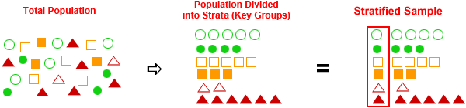
Stratified Sample

Slide 22
Cluster Sampling
Cluster sampling is a sampling technique used when "natural" but relatively homogeneous groupings are evident in a statistical population. It is often used in marketing research.
In this technique, the total population is divided into these groups (or
clusters) and a simple random sample of the groups is selected.

Slide 23
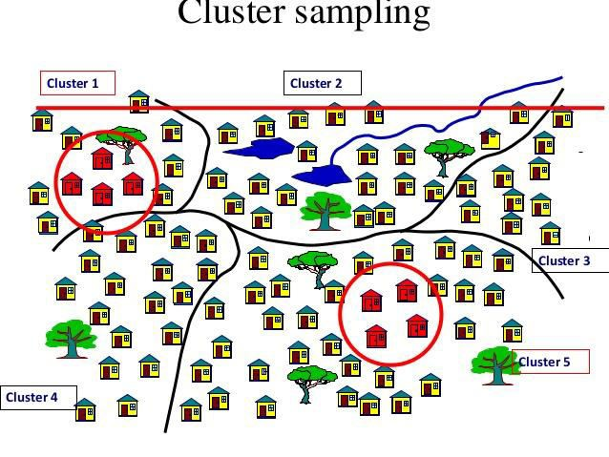
Cluster Sampling

Slide 24
Business Analytics
Business Analytics
Non Probability Sampling
Methods

Slide 25
Non Probability Sampling
As they are not truly representative, non-probability samples are less desirable than probability samples. However, a researcher may not be able to obtain a random or stratified sample, or it may be too expensive.
A researcher may not care about generalizing to a larger population.
The validity of non-probability samples can be increased by trying to approximate random selection, and by eliminating as many sources of bias as possible.

Slide 26
Quota Sample
The defining characteristic of a quota sample is that the researcher
deliberately sets the proportions of levels or strata within the sample. This is generally done to insure the inclusion of a particular segment of the population.
The proportions may or may not differ dramatically from the actual proportion in the population. The researcher sets a quota, independent of population characteristics.

Slide 27
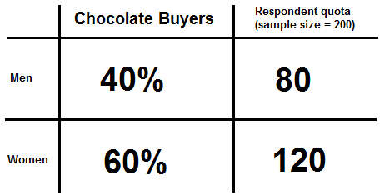
Quota Sample Example

Slide 28
Quota sample
Example:
•A researcher is interested in the attitudes of members of different religions towards the death penalty.
•A random sample might miss Muslims (because there are not many in that state). To be sure of their inclusion, a researcher could set a quota of 3% Muslim for the sample.
•However, the sample will no longer be representative of the actual proportions in the population. This may limit generalizing to the state population. But the quota will guarantee that the views of Muslims are represented in the survey.

Slide 29
Convenience sample
Convenience sampling is a sample taken from a group you have easy access to. The idea is that anything learned from this study will be applicable to the larger population.
By using a large, convenient size, you are able to more confidently say
the sample represents the population.
Furthermore, the convenient group you are testing should not be fundamentally different than if you had taken a sample from another area. If you are trying to say something about women, for example,
then your convenient sample cannot be men.

Slide 30
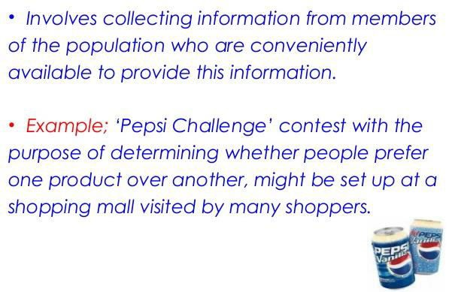
Convenience Sampling Example

Slide 31
Convenience Sample Example
You are interested in the effects of caffeine on study habits of college students. To test the whole population you would need all current college students and a whole lot of time and soda.
A sample would be a test of a few college students from all of the
colleges in the India, requiring you to fly them in for the testing.
A convenience sample would be a large group of college students from your local college or colleges. They are close by, are in college, and are not different than other college students.

Slide 32
Judgment Sample
Judgment sample is a type of nonrandom sample that is selected based on the opinion of an expert.
Results obtained from a judgment sample are subject to some degree
of bias, due to the frame and population not being identical.
The frame is a list of all the units, items, people, etc., that define the population to be studied.
•Example:
•A TV researcher wants a quick sample of opinions about a political announcement. Taking views of people in the street.

Slide 33
Business Analytics
Business Analytics
Sampling & Estimation

Slide 34

Sampling
What is Sampling?
A shortcut method for investigating a whole population
Data is gathered on a small part of the whole parent population or
sampling frame, and used to inform what the whole picture is like.
Why sample?
In reality there is simply not enough; time, energy, money, labor/man power, equipment, access to suitable sites to measure every single item or site within the parent population or whole sampling frame.
Therefore an appropriate sampling strategy is adopted to obtain a
representative, and statistically valid sample of the whole.
34

Slide 35
Sampling
Sampling considerations
Larger sample sizes are more accurate representations of the whole.
The sample size chosen is a balance between obtaining a statistically valid representation, and the time, energy, money, labor, equipment and access available.
A sampling strategy made with the minimum of bias is the most
statistically valid.

Slide 36
Sampling
Most approaches assume that the parent population has a normal distribution where most items or individuals clustered close to the mean, with few extremes
A 95% probability or confidence level is usually assumed, for example 95% of items or individuals will be within plus or minus two standard deviations from the mean
This also means that up to five per cent may lie outside of this - sampling, no matter how good can only ever be claimed to be a very close estimate

Slide 37
Sampling
Sampling techniques
Three main types of sampling strategy:
Random
Systematic
Stratified

Slide 38
Random sampling
Random sampling
Least biased of all sampling techniques, there is no subjectivity each member of the total population has an equal chance of being selected
Can be obtained using random number tables
Microsoft Excel has a function to produce random number
The function is simply:
=rand()

Slide 39
Random sampling
Type rand() into a cell and it will produce a random number in that cell. Copy the formula throughout a selection of cells and it will produce random numbers.
You can modify the formula to obtain whatever range you
wish, for example if you wanted random numbers from one to 250,
you could enter the following formula:
• RANDBETWEEN(1,250)

Slide 40
Advantages & Disadvantages of Random Sampling
Advantages:
Can be used with large sample populations
Avoids bias
Disadvantages:
Can lead to poor representation of the overall parent population or area if large areas are not hit by the random numbers generated.
There may be practical constraints in terms of time available and access to certain parts of the study area

Slide 41
Systematic sampling
Samples are chosen in a systematic, or regular way.
They are evenly/regularly distributed in a spatial context, for example every two meters along a transect line.
They can be at equal/regular intervals in a temporal context, for
example every half hour or at set times of the day.
They can be regularly numbered, for example every 10th house or
person

Slide 42
Advantages & Disadvantages of Systematic Sampling
Advantages:
It is more straight-forward than random sampling
A grid doesn't necessarily have to be used, sampling just has to be at uniform intervals
A good coverage of the study area can be more easily achieved than using random sampling
Disadvantages:
It is more biased, as not all members or points have an equal
chance of being selected
It may therefore lead to over or under representation of a particular pattern
42

Slide 43
Stratified Sampling
This method is used when the parent population or sampling frame is made up of sub-sets of known size. These sub-sets make up different proportions of the total, and therefore sampling should be stratified to ensure that results are proportional and representative of the whole.

Slide 44
Advantages & Disadvantages of Stratified Sampling
Advantages:
It can be used with random or systematic sampling, and with point,
line or area techniques
If the proportions of the sub-sets are known, it can generate results which are more representative of the whole population
It is very flexible and applicable to many geographical enquiries
Correlations and comparisons can be made between sub-sets
Disadvantages:
The proportions of the sub-sets must be known and accurate if it is
to work properly
It can be hard to stratify questionnaire data collection, accurate up to date population data may not be available and it may be hard to identify people's age or social background effectively

Slide 45
Estimation
In statistics, estimation refers to the process by which one makes inferences about a population, based on information obtained from a sample.
An estimator attempts to approximate the unknown parameters
using the measurements.
For example, it is desired to estimate the proportion of a population of voters who will vote for a particular candidate.
•That proportion is the parameter sought; the estimate is based on a small random sample of voters.

Slide 46
Estimation
Estimation is the process of determining a likely value for a population parameter (e.g. the true population mean or proportion) based on a random sample.
In practice, a sample is drawn from the target population, and sample statistics (e.g. the sample mean or sample proportion) are used to generate estimates of the unknown parameter.
The sample should be representative of the population, ideally with participants selected at random from the population.
Because different samples can produce different results, it is necessary to quantify the sampling error or variation that exists among estimates from different samples.

Slide 47
Business Analytics
Business Analytics
Point & Interval Estimates

Slide 48
Point and Interval estimates
The point estimate is our best guess of the true value of the parameter, while the interval estimate gives a measure of accuracy of that point estimate by providing an interval that contains plausible values.
Point estimate:
A point estimate of a population parameter is a single value of a
statistic.
For example, the sample mean x is a point estimate of the population mean μ. “Similarly, the sample proportion p is a point estimate of the population proportion P.

Slide 49
Point and Internal estimates
Interval estimate:
An interval estimate is defined by two numbers, between which a
population parameter is said to lie.
For example, a < x < b is an interval estimate of the population mean μ. It indicates that the population mean is greater than a but less than b.

Slide 50
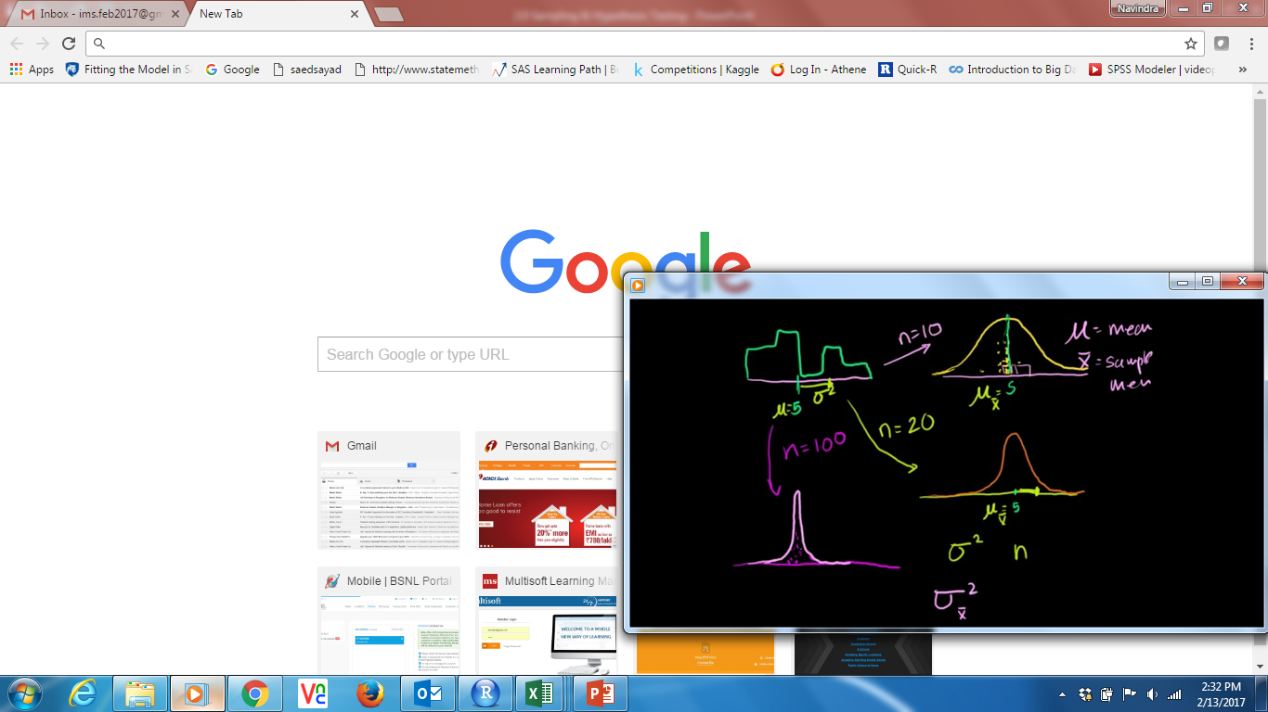
Standard error of the Mean
The standard deviation of the sampling distribution of sample mean ( also called the standard deviation of the mean or the standard error of the mean)
Here , the sample mean will be same as of population mean in each trial ( n = 10, 20, 100), but variance will decrease as the sample size increases.
Hence, sample variance have inverse relationship with sample size
Variance of sample = variance of population/n
SD of sample = SD of population /sqrt(n)
D:\IMS\3. Datasets\XL working file\ sample and sampling distribution

Slide 51
R - Point Estimate of Population Mean
Problem
Find a point estimate of mean university student height with the
sample data from survey.
Solution
For convenience, we begin with storing the survey data of student
heights in the variable height. Survey.
library(MASS)
height.survey= survey$Height
It turns out not all students have answered the question, and we
must filter out the missing values.
50

Slide 52
R - Point Estimate of Population Mean
It turns out not all students have answered the question, and we must filter out the missing values.
Hence we apply the mean function with the "na.rm" argument
as TRUE for skipping the missing values.
mean(height.survey, na.rm = TRUE)
[1] 172.3809
A point estimate of the mean student height is 172.38 centimeters.
51

Slide 53
Interval Estimate of Population Mean-Known Variance
Problem
Assume the population standard deviation σ of the student height in survey is 9.48. Find the margin of error(ME) and interval estimate at 95% confidence level.
Solution
We first filter out missing values in survey$Height with
the na.omit function, and save it in height.response.
library(MASS)
height.response = na.omit(survey$Height)
ME = Critical value( Z or t Value) x Standard error

Slide 54

Interval Estimate of Population Mean-Known Variance
Then we compute the standard error of the mean.
n = length(height.response)
sigma = 9.48 # Population standard deviation (Given/known)
SEmean = sigma/sqrt(n) # Population error of mean
SEmean

Slide 55
Interval Estimate of Population Mean-Known Variance
Since there are two tails of the normal distribution, the 95%
confidence level would imply the 97.5th percentile of the normal distribution at the upper tail. Therefore, in R, zα∕2 is given by qnorm(.975).
We multiply it with the standard error of the mean ( Standard deviation of the sampling distribution of the sample mean) and get the margin of error.
Variance of sample = variance of population /sample size (n)
Or Standard deviation of sample = standard deviation of population/sqrt(sample size)

Slide 56
Interval Estimate of Population Mean-Known Variance
z = qnorm(0.975)
z
# z = qnorm(0.025)
# z
E = qnorm(0.975)*SEmean
E # margin of error
[1] 1.2852
We then add it up with the sample mean, and find the confidence interval as told.
xbar = mean (height.response) # sample mean
xbar + c(-E,E)
[1] 171.0956 173.6661
Assuming the population standard deviation σ being 9.48, the margin of error for the student height survey at 95% confidence level is 1.2852 centimeters. The confidence interval is between 171.10 and
173.67 centimeters.

Slide 57
Interval Estimate of Population Mean-Unknown Variance
Problem ( t distribution)
Without assuming the population standard deviation of the student height in survey, find the margin of error and interval estimate at 95% confidence level.
Solution
We first filter out missing values in survey$Height with
the na.omit function, and save it in height.response.
library(MASS)
height.response = na.omit(survey$Height)
# Then we compute the sample standard deviation
n= length(height.response)
s = sd(height.response) # sample standard deviation
SE = s/sqrt(n) # standard error estimate
SE
[1] 0.6811677

Slide 58
Interval Estimate of Population Mean-Unknown Variance
Since there are two tails of the Student t distribution, the 95% confidence level would imply the97.5th percentile of the Student t distribution at the upper tail.
Therefore, tα∕2 is given by qt(.975, df=n-1).
We multiply it with the standard error estimate SE and get the
margin of error.
E = qt(0.975, n-1)*SE# margin of error for two tail test at 95% confidence
E
[1] 1.517021
We then add it up with the sample mean, and find the confidence
interval.
xbar = mean(height.response) # sample mean
xbar+ c(-E,E)
[1] 170.9593 173.9933

Slide 59
Interval Estimate of Population Mean-Unknown Variance
Without assumption on the population standard deviation, the margin of error for the student height survey at 95% confidence level is 1.97 centimeters. The confidence interval is between 170.9593 and 173.9923 centimeters.
170.9593 173.9933

Slide 60
Sampling using R
R has the ability to sample with and without replacement.
•That is, choose at random from a collection of things such as the numbers 1 through 6 in the dice rolling example.
The sampling can be done with replacement (like dice rolling) or
without replacement (like a lottery).
By default sample without replacement ,each object having equal chance of being picked.
You need to specify replace=TRUE if you want to sample with replacement. Furthermore, you can specify separate probabilities for each if desired.

Slide 61
R Codes
Here are some examples
# roll a die
sample(1:6,10,replace = TRUE) # putting back for throw
[1] 1 5 2 5 5 2 6 4 5 6
# Toss a coin
sample(c("H","T"),10,replace=TRUE)
[1] "H" "T" "T" "H" "H" "T" "H" "H" "H" "T“
# pick 40 of 54 ( a lottery)
sample(1:54,40) # without replacement
sample(1:54,40, replace=TRUE) # with replacement

Slide 62
R Codes
Card suits :- Hearts (♥), diamonds (♦), spades (♠) and clubs (♣)
### pick a card
x <- c("A",2:10,"J","Q","K")
y <- rep(c("A",2:10,"J","Q","K"),4)
z <- c("H","D","S","C")
cards1= paste(c("A",2:10,"J","Q","K"),c("H","D","S","C"))
cards= paste(rep(c("A",2:10,"J","Q","K"),4),c("H","D","S","C"))
sample(cards,5) # a pair of 5 without replacement
#### Roll 2 Dice
x <- 1:9
y <- 2:8
nnn <- outer(y, x, "*")
TTT <- outer(y, x, "^")
abc <- outer(y, x, paste)
dice2 = outer(1:6,1:6,paste)
sample(dice2,5,replace= TRUE)
dice = as.vector(outer(1:6,1:6,paste))
sample(dice,5,replace= TRUE) # replacing when rolling die
dace3 <- as.data.frame(dice2)
sample(dice3,5,replace= TRUE)

Slide 63
Hypothesis Testing
Develop null and alternative hypotheses to test for a given situation.
Understand the difference between one- and two-tailed hypothesis tests.
Understand Type I and Type II error

Slide 64
Hypothesis Introduction
In everyday life, we often have to make decisions based on incomplete information. These may be decisions that are important to us such as, "Will I improve my biology grades if I spend more time studying vocabulary?" or "Should I become a chemistry major to increase my chances of getting into med school?" This section is about the use of hypothesis testing to help us with these decisions.
Hypothesis testing is a kind of statistical inference that involves asking a question, collecting data, and then examining what the data tells us about how to proceed.

Slide 65
Hypothesis Introduction
In a formal hypothesis test, hypotheses are always statements about the population. The hypothesis tests that we will examine in this chapter involve statements about the average values (means) of some variable in the population.
For example, we may want to know if the average time that college freshmen spend studying each week is really 20 hours per week. We may want to compare this average time spent studying for freshmen that earned a GPA of 3.0 or higher and those that did not. In later chapters, we will be able to test if the average time studying differs for four groups: freshmen, sophomores, juniors and seniors.

Slide 66
Developing Null and Alternative Hypotheses
In statistical hypothesis testing, there are always two hypotheses. The hypothesis to be tested is called the null hypothesis and given the
sy
The null hypothesis states that there is no difference between a hypothesized population mean and a sample mean. It is the status quo hypothesis.
For example, if we were to test the hypothesis that college freshmen study 20 hours per week, we would express our null hypothesis as:
mbol

Slide 67

Alternative Hypothesis
We test the null hypothesis against an alternative hypothesis, which is given the symbol
The alternative hypothesis is often the hypothesis that you believe yourself! It includes the outcomes not covered by the null hypothesis. In this example, our alternative hypothesis would express that freshmen do not study 20 hours per week

Slide 68

Example A
We have a medicine that is being manufactured and each pill is supposed to have 14 milligrams of the active ingredient. What are our null and alternative hypotheses ?
Solution:-
Our null hypothesis states that the population has a mean equal to 14 milligrams. Our alternative hypothesis states that the population has a mean that is different than 14 milligrams.

Slide 69
Decision Criterion: One & Two-Tailed Hypothesis Tests
The alternative hypothesis can be supported only by rejecting the null hypothesis.
To reject the null hypothesis means to find a large enough difference between your sample mean and the hypothesized (null) mean that it raises real doubt that the true population mean is 20.
If the difference between the hypothesized mean and the sample mean is very small, we do not. In each hypothesis test, we have to decide in advance what the magnitude of that difference must be to allow us to reject the null hypothesis.
Below is an overview of this process. Notice that if we fail to find a large enough difference to reject, we fail to reject the null hypothesis. very large, we reject the null hypothesis.

Slide 70
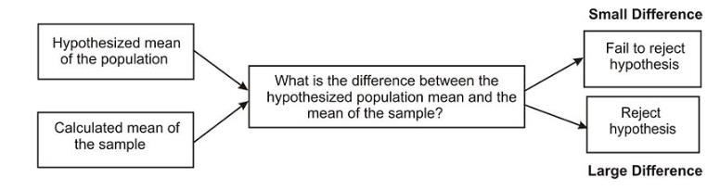
Hypothesis Tests
When a hypothesis is tested, a statistician must decide on how much of a difference between means is necessary in order to reject the null hypothesis.
Statisticians first choose a level of significance or alpha
hypothesis test.
Similar to the significance level you used in constructing confidence intervals, this alpha level tells us how improbable a sample mean must be for it to be deemed "significantly different" from the hypothesized mean.
le
vel for their

Slide 71
Hypothesis Tests
The most frequently used levels of significance are 0.05 and 0.01.
An alpha level of 0.05 means that we will consider our sample mean to be significantly different from the hypothesized mean if the chances of observing that sample mean are less than 5%.
Similarly, an alpha level of 0.01 means that we will consider our sample mean to be significantly different from the hypothesized mean if the chances of observing that sample mean are less than 1%.

Slide 72
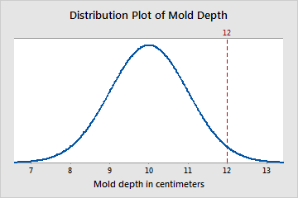
What is a Z-value?
The Z-value is a test statistic for Z-tests that measures the difference between an observed statistic and its hypothesized population parameter in units of standard error. For example, a selection of factory molds has a mean depth of 10cm and a standard deviation of 1 cm. A mold with a depth of 12 cm has a Z-value of 2, because its depth is two standard deviations greater than the mean. The vertical line represents this observation, and its location relative to the entire population:

Slide 73
What is a Z-value?
Converting an observation to a Z-value is called standardization. To standardize a observation in a population, subtract the population mean from the observation of interest and divide the result by the population standard deviation. The result of these calculations is the Z- value associated with the observation of interest.

Slide 74
What is a Z-value?
You can use the Z-value to determine whether to reject the null hypothesis. To determine whether to reject the null hypothesis compare the Z-value to your critical value, which can be found in a standard normal table in most statistics books. The critical value is Z_{1-α/2} for a two sided test and Z_{1-α} for a one sided test. If the absolute value of the Z- value is greater than the critical value, you reject the null hypothesis. If it is not, you fail to reject the null hypothesis.
For example, you want to know whether a second group of molds also has a mean depth of 10cm. You measure the depth of each mold in the second group, and calculate the group's mean depth. A 1-sample Z-test calculates a Z-value of -1.03. You choose an α of 0.05, which results in a critical value of 1.96. Because the absolute value of the Z-value is less than 1.96, you fail to reject the null hypothesis and cannot conclude that the mold's mean depth is different from 10cm.

Slide 75
What is a t-value?
The t-value is a test statistic for t-tests that measures the difference between an observed sample statistic and its hypothesized population parameter in units of standard error.
A t-test compares the observed t-value to a critical value on the t- distribution with (n-1) degrees of freedom to determine whether the difference between the estimated and hypothesized values of the population parameter is statistically significant.
Applications of t-values include:
comparing two sample means
comparing the means of paired observations
determining the significance of a regression coefficient
comparing two regression coefficients

Slide 76
What is a t-value?
You can also use t-values in a 1-sample t-test. For example, you want to determine whether the length of a manufactured part meets its target value of 10cm. You take a sample of 50 parts, conduct a two-sided 1- sample t-test on their mean length with the following hypotheses:
H₀: μ = 0 (the mean length of all parts meets the target value )
H₁: μ ≠ 0 (the mean length of all parts does not meet the target value) The test produces a t-value of 2.5. On the t-distribution with (n-1 = 49) degrees of freedom, this t-value corresponds to a p-value of 0.0158.
For most common significance levels, this result is statistically significant. Therefore, you reject the null hypothesis that the mean length meets the target, and conclude that the process needs improvement.

Slide 77
P-Value
All hypothesis tests ultimately use a p-value to weigh the strength of the evidence (what the data are telling you about the population). The p-value is a number between 0 and 1 and interpreted in the following way:
A small p-value (typically Š 0.05) indicates strong evidence against the null hypothesis, so you reject the null hypothesis.
A large p-value (> 0.05) indicates weak evidence against the null hypothesis, so you fail to reject the null hypothesis.
p-values very close to the cutoff (0.05) are considered to be marginal (could go either way). Always report the p-value so your readers can draw their own conclusions.

Slide 78
P-Value
For example, suppose a pizza place claims their delivery times are 30
minutes or less on average but you think it’s more than that.
You conduct a hypothesis test because you believe the null hypothesis, H_{o}, that the mean delivery time is 30 minutes max, is incorrect. Your alternative hypothesis (H_{a}) is that the mean time is greater than 30 minutes.
You randomly sample some delivery times and run the data through the hypothesis test, and your p-value turns out to be 0.001, which is much less than 0.05. In real terms, there is a probability of 0.001 that you will mistakenly reject the pizza place’s claim that their delivery time is less than or equal to 30 minutes.

Slide 79
P-Value
Since typically we are willing to reject the null hypothesis when this probability is less than 0.05, you conclude that the pizza place is wrong; their delivery times are in fact more than 30 minutes on average, and you want to know what they’re gonna do about it!
(Of course, you could be wrong by having sampled an unusually high number of late pizza deliveries just by chance.)

Slide 80
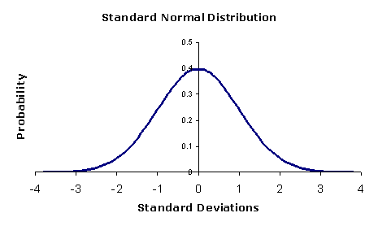
What is a Z score ? What is a P-value?
The Z score is a test of statistical significance that helps you decide whether or not to reject the null hypothesis.
The p-value is the probability that you have falsely rejected the null
hypothesis.

Slide 81
What is a Z score ? What is a P-value?
Z scores are measures of standard deviation. For example, if a tool returns a Z score of +2.5 it is interpreted as "+2.5 standard deviations away from the mean".
P-values are probabilities. Both statistics are associated with the standard normal distribution. This distribution relates standard deviations with probabilities and allows significance and confidence to be attached to Z scores and p-values.

Slide 82
T-Score vs. Z-Score: What’s the Difference?
A z-score and a t-score are both used in hypothesis testing.
Few topics in elementary statistics cause more confusion to students than deciding when to use the z-score and when to use the t-score.
Generally, you’ll use a z-score in testing more often than a t-score.
The general rule of thumb for when to use a t-score is when your sample size meets the following two requirements:
The sample size is below 30
The population standard deviation is unknown (estimated from your sample data)

Slide 83
T-Score vs. Z-Score: What’s the Difference?
In other words, you must know the standard deviation of
the population and your sample size must be above 30 in order for you
to be able to use the z-score. Otherwise, use the t-score.
Note: You can estimate the population standard deviation, σ by using the standard deviation of the sample, s. However, you can only do this if your sample is 30 or above.

Slide 84
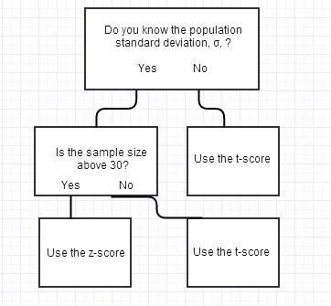
T-Score vs. Z-Score: What’s the Difference?

Slide 85
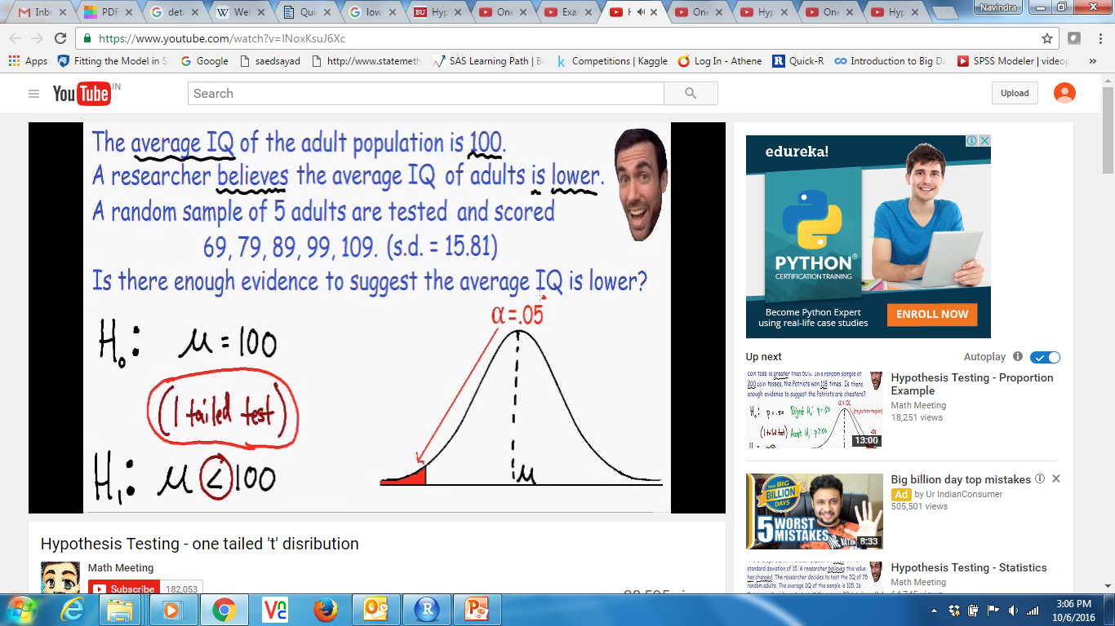
Lower Tail Test of Population Mean-Known Variance
Problem
Suppose the manufacturer claims that the mean lifetime of a light bulb is more than 10,000 hours. In a sample of 30 light bulbs, it was found that they only last 9,900 hours on average. Assume the population standard deviation is 120 hours. At .05 significance level, can we reject the claim by the manufacturer and say that average lifetime is less than 10,000 Hrs?
Null hypothesis : μo = 10000
Alternative hypothesis : μ1 < 10000
( less than or greater than to indicates one tail test

Slide 86
Lower Tail Test of Population Mean-Known Variance
Solution
The null hypothesis is that μ Š 10000. We begin with computing the test statistic.
xbar = 9900 # sample mean
mu0 = 10000 # Hypothesized value
sigma = 120 # Population standard deviation
n = 30 # sample size
z= (xbar-mu0)/(sigma/sqrt(n))
Z
[1] -4.564355
We then compute the critical value at .05 significance level.
alpha = 0.05
z.alpha = qnorm(1-alpha)
-z.alpha # multiply withe negative for lower tail
[1] – 1.644853
-4.56
-1.644

Slide 87
Interpreting Output
Answer
The test statistic -4.5644 is less than the critical value of -1.6449. Hence, at .05 significance level, we reject the claim that mean lifetime of a light bulb is above 10,000 hours.
Alternative Solution
Instead of using the critical value, we apply the pnorm function to compute the lower tail p-value of the test statistic. As it turns out to be less than the .05 significance level, we reject the null hypothesis
that μ Š 10000.
pval = pnorm(z)
pval
[1] 2.505166e-06

Slide 88
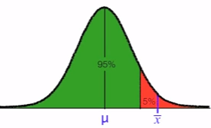
Upper Tail Test of Population Mean-Known Variance
Problem
Suppose the food label on a cookie bag states that there is at most 2 grams of saturated fat in a single cookie. In a sample of 35 cookies, it is found that the mean amount of saturated fat per cookie is 2.1 grams.
Assume that the population standard deviation is 0.25 grams. At .05 significance level, can we reject the claim on food label?
Null hypothesis : μo = 2
Alternative hypothesis : μ1 > 2
1.64
2.36

Slide 89
Upper Tail Test of Population Mean-Known Variance
Solution
The null hypothesis is that μ Š 2. We begin with computing the test statistic.
xbar = 2.1 # sample mean
mu0 = 2 # Hypothesized value
sigma = 0.25 # Population standard deviation
n = 35 # sample size
z = (xbar-mu0)/(sigma/sqrt(n))
z # test statistics
# [1] 2.366432
We then compute the critical value at .05 significance level.
alpha = 0.05
z.alpha = qnorm(1- alpha)
z.alpha
# [1] 1.644854
89

Slide 90
Interpreting Output
Answer
The test statistic 2.3664 is greater than the critical value of 1.6449. Hence, at .05 significance level, we reject the claim that there is at most 2 grams of saturated fat in a cookie.
Alternative Solution
Instead of using the critical value, we apply the pnorm function to compute the upper tail p-value of the test statistic. As it turns out to be less than the .05 significance level, we reject the null hypothesis
that μ Š 2.
pval = pnorm(z, lower.tail= FALSE)
pval
# [1] 0.008980239

Slide 91
Two-Tailed Test of Population Mean-Known Variance
Problem
Suppose the mean weight of King Penguins found in an Antarctic colony last year was 15.4 kg. In a sample of 35 penguins same time this year in the same colony, the mean penguin weight is 14.6 kg. Assume the population standard deviation is 2.5 kg. At .05 significance level, can we reject the null hypothesis that the mean penguin weight does not differ from last year?

Slide 92
Two-Tailed Test of Population Mean-Known Variance
Solution
The null hypothesis is that μ = 15.4. We begin with computing the test statistic.
xbar = 14.6 # sample mean
mu0 = 15.4 # hypothesized value
sigma = 2.5 # Population standard deviation
n = 35 # sample size
z = (xbar-mu0)/(sigma/sqrt(n))
z # Test statistics
# [1] -1.893146
We then compute the critical values at .05 significance level.
alpha = 0.05
z.half.alpha= qnorm(1-alpha/2)
c(-z.half.alpha, z.half.alpha)
# [1] -1.959964 1.959964

Slide 93
Interpreting Output
Answer
The test statistic -1.8931 lies between the critical values -1.9600 and 1.9600. Hence, at .05 significance level, we do not reject the null hypothesis that the mean penguin weight does not differ from last year.
Alternative Solution
Instead of using the critical value, we apply the pnorm function to compute the two-tailed p-value of the test statistic. It doubles
the lower tail p-value as the sample mean is less than the hypothesized value. Since it turns out to be greater than the .05 significance level, we do notreject the null hypothesis that μ = 15.4.
pval = 2*pnorm(z)
Pval
# [1] 0.05833852

Slide 94
Lower Tail Test of Population Mean-Unknown Variance
Problem
Suppose the manufacturer claims that the mean lifetime of a light bulb is more than 10,000 hours. In a sample of 30 light bulbs, it was found that they only last 9,900 hours on average. Assume the sample standard deviation is 125 hours. At .05 significance level, can we reject the claim by the manufacturer? ( t test)

Slide 95
Lower Tail Test of Population Mean-Unknown Variance
Solution
The null hypothesis is that μ Š 10000. We begin with computing the test statistic.
xbar = 9900 # sample mean
mu0 = 10000 # hypothesized value
s = 125 # sample standard deviation
n = 30 # sample size
t= (xbar-mu0)/(s/sqrt(n))
t # test statistics
# [1] -4.38178
We then compute the critical value at .05 significance level.
alpha = 0.05
t.alpha = qt(1- alpha, df = n-1)
- t.alpha # critical value
# [1] -1.699127
The test statistic -4.3818 is less than the critical value of -1.6991. Hence, at .05 significance level, we can reject the claim that mean lifetime of a light bulb is above 10,000 hours.

Slide 96
Interpreting Output
Alternative Solution
Instead of using the critical value, we apply the pt function to compute the lower tail p-value of the test statistic. As it turns out to be less than the .05 significance level, we reject the null hypothesis that μ Š 10000.
pval = pt(t,df = n-1)
pval
# [1] 7.035026e-05

Slide 97
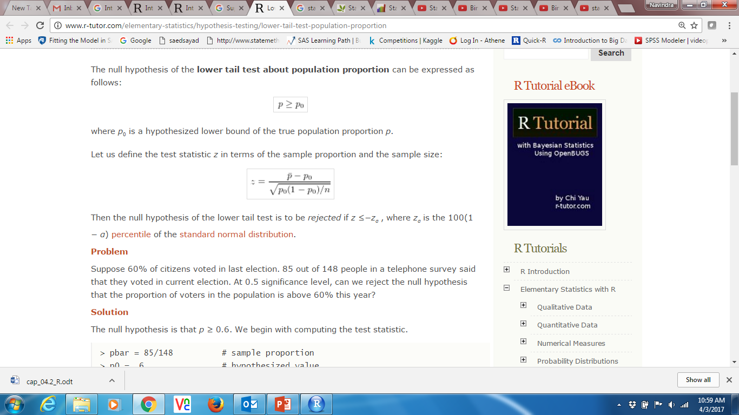
Lower Tail Test of Population Proportion
Problem
Suppose 60% of citizens voted in last election. 85 out of 148 people in a telephone survey said that they voted in current election. At 0.5 significance level, can we reject the null hypothesis that the proportion of voters in the population is above 60% this year?
Z value of of binomial distribution

Slide 98
Lower Tail Test of Population Proportion
Solution
The null hypothesis is that p Š 0.6. We begin with computing the test
statistic.
pbar = 85/148 # sample proportion
p0 = 0.6 # hypothesized value
n = 148 # sample size
z=(pbar-p0)/(sqrt(p0*(1-p0)/n))
z
# [1] -0.6375983
We then compute the critical value at .05 significance level.
alpha = 0.05
z.alpha = qnorm(1-alpha)
-z.alpha
# [1] -1.644854

Slide 99
Interpreting Output
Answer
The test statistic -0.6376 is not less than the critical value of -1.6449. Hence, at .05 significance level, we do not reject the null hypothesis that the proportion of voters in the population is above 60% this year.
Alternative Solution 1
Instead of using the critical value, we apply the pnorm function to compute the lower tail p-value of the test statistic. As it turns out to be greater than the .05 significance level, we do not reject the null hypothesis that p Š 0.6.
pval = pnorm(z) # lower tail p value
pval
# [1] 0.2618676

Slide 100
Business Analytics
Business Analytics
Types of Error, Power of the Test

Slide 101
Type I & Type II Error
Type I Error:
A Type I error occurs if we reject the null hypothesis H0 (in favor of
the alternative hypothesis HA) when the null hypothesis H0 is true.
We denote α = P(Type I Error).
Type II Error:
A Type II error occurs if we fail to reject the null
hypothesis H0 when the alternative hypothesis HA is true.
We denote β = P(Type II Error).

Slide 102
Type I & Type II Error
When you do a hypothesis test, two types of errors are possible: type I and type II.
The risks of these two errors are inversely related and determined
by the level of significance and the power for the test.
Therefore, you should determine which error has more severe
consequences for your situation before you define their risks.
No hypothesis test is 100% certain. Because the test is based on probabilities, there is always a chance of drawing an incorrect conclusion.

Slide 103
Type I & Type II Error
Type I error
When the null hypothesis is true and you reject it, you make a type I error. The probability of making a type I error is α, which is the level of significance you set for your hypothesis test. An α of 0.05 indicates that you are willing to accept a 5% chance that you are wrong when you reject the null hypothesis.
To lower this risk, you must use a lower value for α. However, using a lower value for alpha means that you will be less likely to detect a true difference if one really exists. ( Thinks as a share market, higher the risk , higher the return)

Slide 104
Type I & Type II Error
Type II error
When the null hypothesis is false and you fail to reject it, you make a type II error. The probability of making a type II error is β, which depends on the power of the test. You can decrease your risk of committing a type II error by ensuring your test has enough power.
You can do this by ensuring your sample size is large enough to detect a practical difference when one truly exists. The probability of rejecting the null hypothesis when it is false is equal to 1–β. This value is the power of the test.
The probability to fail to reject a null hypothesis when it is false is β
The probability to reject the null hypothesis when it is false is 1- β

Slide 105
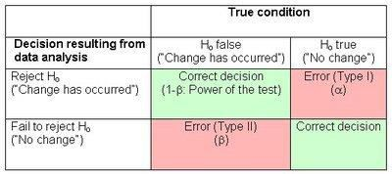
Type I & Type II Error
Reverse interpreatation

Slide 106
Type I & Type II Error
Examples of type I and type II error
To understand the interrelationship between type I and type II error, and to determine which error has more severe consequences for your situation, consider the following example.
A medical researcher wants to compare the effectiveness of two medications. The null and alternative hypotheses are:
Null hypothesis (H0): μ1= μ2
The two medications are equally effective.
Alternative hypothesis (H1): μ1≠ μ2
The two medications are not equally effective.

Slide 107
Type I & Type II Error
A type I error occurs if the researcher rejects the null hypothesis and concludes that the two medications are different when, in fact, they are not.
If the medications have the same effectiveness, the researcher may not consider this error too severe because the patients still benefit from the same level of effectiveness regardless of which medicine they take.
However, if a type II error occurs, the researcher fails to reject the null hypothesis when it should be rejected. That is, the researcher concludes that the medications are the same when, in fact, they are different.
This error is potentially life-threatening if the less-effective medication is sold to the public instead of the more effective one.

Slide 108
Type I & Type II Error
As you conduct your hypothesis tests, consider the risks of making type I and type II errors. If the consequences of making one type of
error are more severe or costly than making the other type of error, then choose a level of significance and a power for the test that will reflect the relative severity of those consequences.

Slide 109
Power of Test
What is the power of a test?
The power of a statistical test gives the likelihood of rejecting the
null hypothesis when the null hypothesis is false.
Just as the significance level (alpha) of a test gives the probability that the null hypothesis will be rejected when it is actually true (a wrong decision), power quantifies the chance that the null hypothesis will be rejected when it is actually false (a correct decision).
Thus, power is the ability of a test to correctly reject the null hypothesis.
D:\IMS\Video download\Calculating Statistical Power Tutorial 2
https://onlinecourses.science.psu.edu/stat414/book/export/html/245
https://www.youtube.com/watch?v=7mE-K_w1v90

Slide 110
Power of Test
Why is it important?
Although you can conduct a hypothesis test without it, calculating the power of a test beforehand will help you ensure that the sample size is large enough for the purpose of the test.
Otherwise, the test may be inconclusive, leading to wasted resources.
On rare occasions the power may be calculated after the test is performed, but this is not recommended except to determine an adequate sample size for a follow-up study

Slide 111
Power of Test
How is it calculated?
As an example, consider testing whether the average time per week spent watching TV is 4 hours versus the alternative that it is greater than 4 hours.
We will calculate the power of the test for a specific value under
the alternative hypothesis, say, 7 hours:
The Null Hypothesis is H0: μ = 4 hours
The Alternative Hypothesis is H1: μ = 6 hours
Where μ = the average time per week spent watching TV.

Slide 112
Power of Test
Under the null hypothesis μ is written as μ0 and under the alternative it is written as μ1. “o here μ0 = 4 and μ1 = 6.
Suppose the standard deviation from past data is known to be 2 hours. To find the power of this test for a sample size of 4:

Slide 113


Power of Test
At the 5% significance level, the decision criterion for the test is to reject H0 if Z > 1.645, where
The 5% critical value from the standard normal distribution is 1.645. Equating the critical Z-value to the calculated Z gives the corresponding (hypothetical) sample mean value:

Slide 114

Power of Test
Calculate the Z-statistic assuming the alternative hypothesis is
true, i.e., μ1 = 6:
P(Z > -0.355) = 0.6387. The power of the test is approximately 64%. In general, tests with 80% power and higher are considered to be statistically powerful.

Slide 115
Thank You

